Slide 1
Attribute-based Image Retrieval using Convolutional Neural Networks
Mridul Banik, Sanket Mayuresh Bhave and Shreya Anilkumar

Slide 2
Problem statement
Image mining deals with digging relevant images and extracting patterns from a targeted database of images
Implement an efficient image retrieval system that focuses on high accuracy and tries to identify any (possible) relations with the images already known.

Slide 3
Methodology
Dataset used: CelebA (Samples: 202K, size: 1.5 GB)
Building a Custom Data Loader:
It should give an appropriate train, validation and test set when asked for the same.
It should give an image along with its attributes converted to tensors.
Data pre-processing and EDA:
All images in the train dataset are resized to (299, 299).
All images are converted from BGR to RGB
1 represents if attribute present, 0 if absent

Slide 4
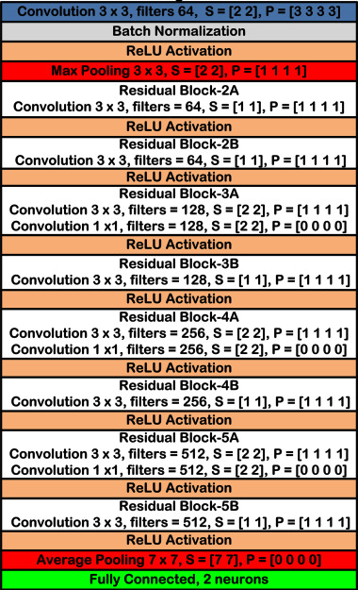
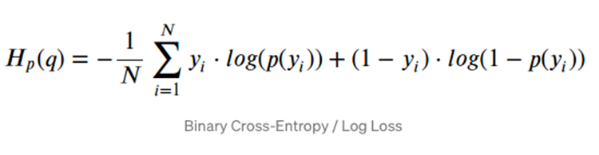
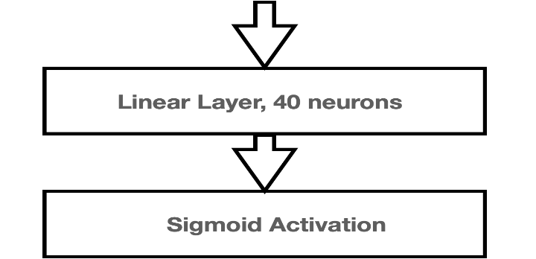
Methodology
Convolutional Neural Network Model:
The team finalized Resnet 18. This model was chosen as it was lighter than all other models.
Cost Function:

Slide 5
Methodology
Query phase
Training phase
Take input image from the user
Create custom dataset object
Load the model
Create a sampler to distribute data
Create a sampler to distribute data
Train the model on ‘n’ nodes
Query the image on the entire data
Save the model
Each node will report its top 3 images

Slide 6
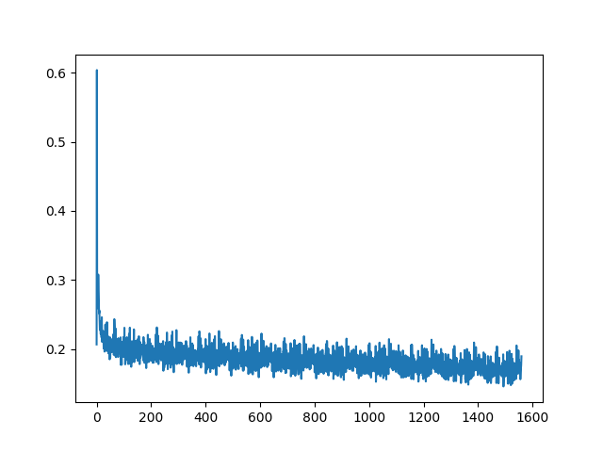
Results, Experiments and Evaluation
The dataset was divided into ‘n’ equal parts
Each node worked on its own partition of the data.
We evaluated our model on validation set which had around 20K samples.
We came across a simple metric- Calculating differences between the actual and predicted class values which we can call as “evaluating partitions”.
This includes many metrics like F1 score, accuracy, hamming loss, exact match ratio, etc.
We did not have fixed classes for any image
Hence, decided to use average difference between actual and predicted labels as a loss.
Validation loss curve

Slide 7
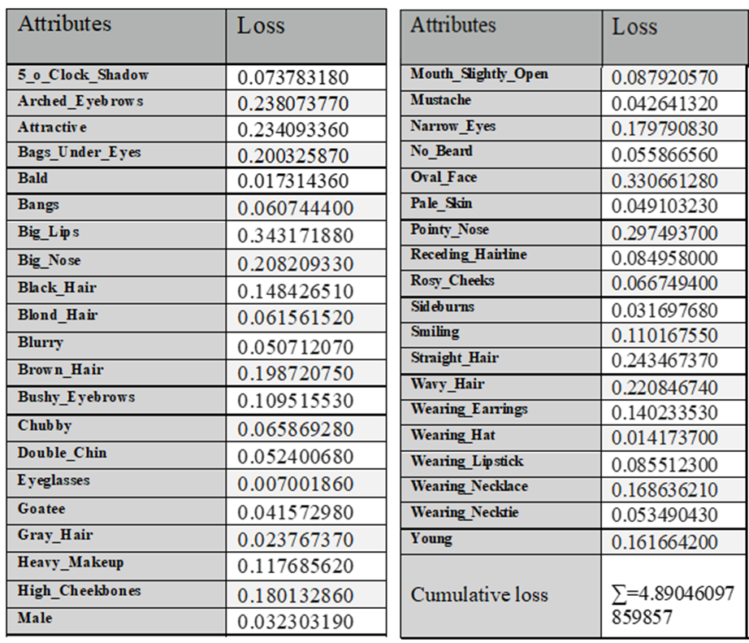
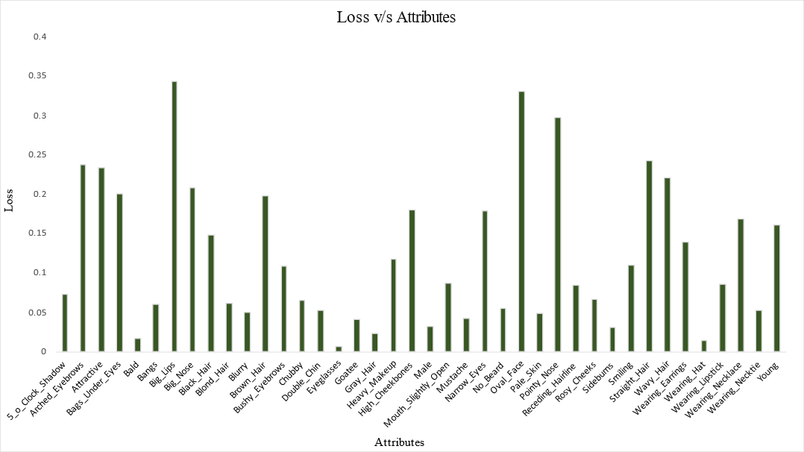
Results, Experiments and Evaluation
we decided to give the average difference as our loss, accordingly, we have the following per-attribute loss:

Slide 8
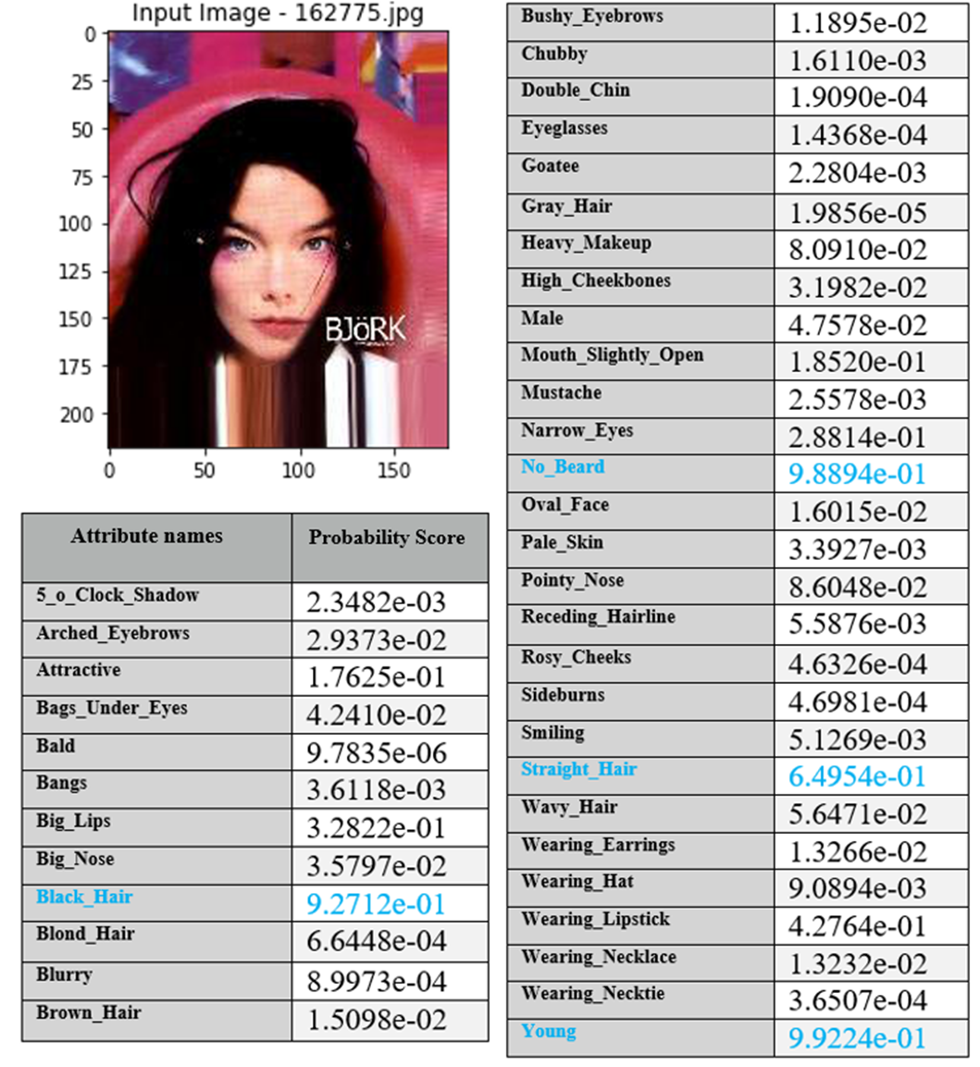
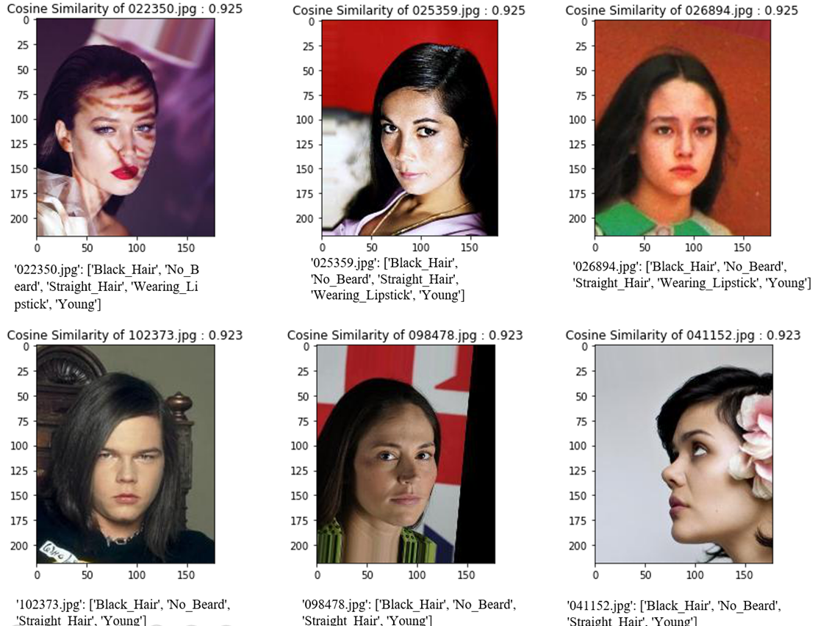
Results, Experiments and Evaluation
Similarity wise content retrieval:
Choose an input image randomly from the test set. Takes input of how many top similar images the user likes to see
Iterate through train images and store the information of image id and its cosine similarity value by comparing with input image
To get the attribute list of output images, the ground truth of attribute list of corresponding images is stored.

Slide 9
Conclusion
Thus, we successfully built an image retrieval system with the use of ResNet-18 model.
We attained a loss of 4.89 as a classification error on our model.
The model we built successfully takes an input image, extracts the attributes from the same and does a similarity match with pre-existed images in our dataset.
Furthermore, we did our training in a distributed environment with 4+ nodes using the power of distributed PyTorch packages.
As a part of future work, we plan to add image descriptors to our attribute vector to make our query system more efficient.

